Slide 1
Applications of text mining and NLP
Pablo Mosteiro
(with slides by Anastasia Giachanou, Javier García Bernardo, and Ayoub Bagheri)

Slide 2
Summary: the text-mining toolkit
One-minute paper
Notes:
Afterwards, collect answers on board

Slide 3
Summary: the text-mining toolkit
Text -> Numeric
TF; TF-IDF; Word embeddings
Similarity (often cosine similarity)
Clustering
LDA
Classification
LogisticRegression
Neural Networks
Feed-forward, RNN, LSTM, CNN, Transformers

Slide 4
A collection of text mining applications
Can you think of some text mining applications?
Think-Pair-Share
Notes:
Then collect on board

Slide 5
A collection of text mining applications
Similarity
Find authors of an anonymous book
Find duplicates and link records
Find relevant documents given a user query
Clustering
Targeted advertisement or learning
Recommendation systems
Clustering stories (clustering fiction works, people’s diagnoses, misinformation)
Track evolution of topics in discourse
Classification/Regression
Hate speech classification (similar: spam, fake news)
Sentiment and emotion analysis
Predict student performance
Probability of re-hospitalization
Classifying medical reports
Predict stock market returns

Slide 6
Today
Applications of text mining
Fake news detection
Hate speech detection
Text clustering in media
Healthcare applications
Interpretability

Slide 7
Today
Applications of text mining
Fake news detection
Hate speech detection
Text clustering in media
Healthcare applications
Interpretability

Slide 8
Definition of fake news
A news article that is intentionally and verifiably false
emphasizes both news authenticity and intentions
ensures the posted information is news by investigating if its publisher is a news outlet
K. Shu, A. Sliva, S. Wang, J. Tang, and H. Liu. (2017). Fake news detection on social media: A data mining perspective. ACM SIGKDD Explorations Newsletter 19, 1 (2017), 22–36
Notes:
This narrow definition addresses the public’s perception of fake news

Slide 9
Difficult to be detected by humans
Human ability to detect deception: accuracy 55%-58% [0]
Individuals trust fake news:
after repeated exposures (validity effect [1]),
if it confirms their preexisting beliefs (confirmation bias [2]),
if it pleases them (desirability bias [3])
Peer pressure “controls” our perception and behavior (e.g., bandwagon effect [4])
[0] Rubin, V. L. (2010). On deception and deception detection: Content analysis of computer‐mediated stated beliefs. Proceedings of the American Society for Information Science and Technology, 47(1), 1-10.
[1] Boehm, L. E. (1994). The validity effect: A search for mediating variables. Personality and Social Psychology Bulletin, 20(3), 285-293.
[2] Nickerson, R. S. (1998). Confirmation bias: A ubiquitous phenomenon in many guises. Review of general psychology, 2(2), 175-220.
[3] Fisher, R. J. (1993). Social desirability bias and the validity of indirect questioning. Journal of consumer research, 20(2), 303-315.
[4] Leibenstein, H. (1950). Bandwagon, snob, and Veblen effects in the theory of consumers' demand. The quarterly journal of economics, 64(2), 183-207.
Notes:
Studies in social psychology and communications have demonstrated that human ability to detect deception is only slightly better than chance: typical accuracy rates are in the 55%-58% range, with a mean accuracy of 54% over 1,000 participants in over 100 experiments [Rubin 2010]. The situation is more critical for fake news than other types of information.
For news, where one expects authenticity and objectivity, it is relatively easier to gain public trust. In addition, individuals tend to trust fake news after repeated exposures (validity effect [Boehm 1994]), or if it confirms their preexisting beliefs (confirmation bias [Nickerson 1998]) or attitudes (selective exposure [Freedman and Sears 1965; Metzger et al. 2015]), or if it pleases them (desirability bias [Fisher 1993]).
Peer pressure can also at times “control” our perception and behavior (e.g., bandwagon effect [Leibenstein 1950]).

Slide 10
Travel fast and more
Compared to the truth, fake news on Twitter
is retweeted by many more users, and
spreads far more rapidly (especially political)
During the 2016 U.S. presidential election campaign:
top 20 fake election stories generated 8,711,000 shares, reactions, and comments on Facebook
7,367,000 for the top 20 most-discussed election stories
S. Vosoughi, D. Roy, and S. Aral. (2018). The spread of true and false news online. Science 359, 6380, 1146–1151.
C. Silverman. (2016). This analysis shows how viral fake election news stories outperformed real news on Facebook. BuzzFeed News 16

Slide 11
The role of content
Where does text mining come in?

Slide 12
The role of content
Fake news ?= truth:
writing style and quality (Undeutsch hypothesis)
quantity such as word counts (information manipulation theory)
sentiments expressed (four-factor theory)
U. Undeutsch. 1967. Beurteilung der glaubhaftigkeit von aussagen. Handbuch der psychologie 11, 26–181
S. A McCornack, K. Morrison, J. E. Paik, A. M Wisner, and X. Zhu. 2014. Information manipulation theory 2: A propositional theory of deceptive discourse production. Journal of Language and Social Psychology 33, 4 (2014), 348–377
M. Zuckerman, B. M DePaulo, and R. Rosenthal. 1981. Verbal and Nonverbal Communication of Deception1. In Advances in experimental social psychology. Vol. 14. Elsevier, 1–59

Slide 13
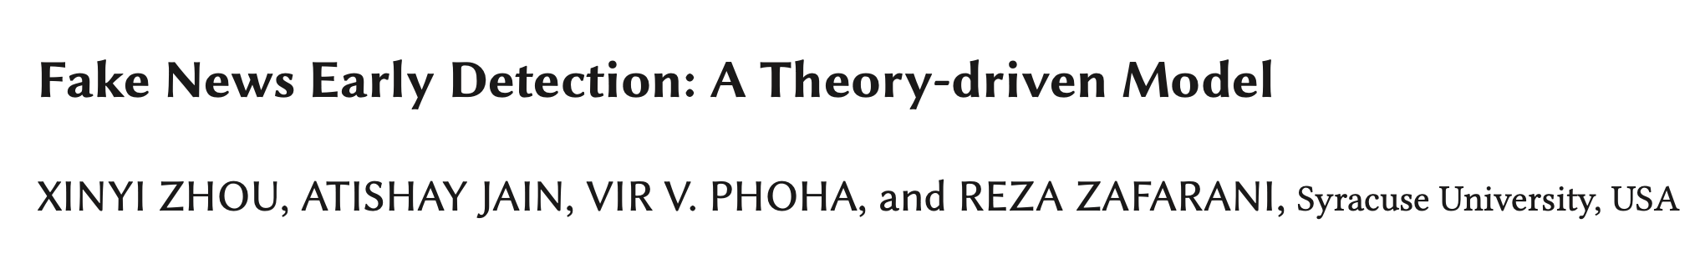
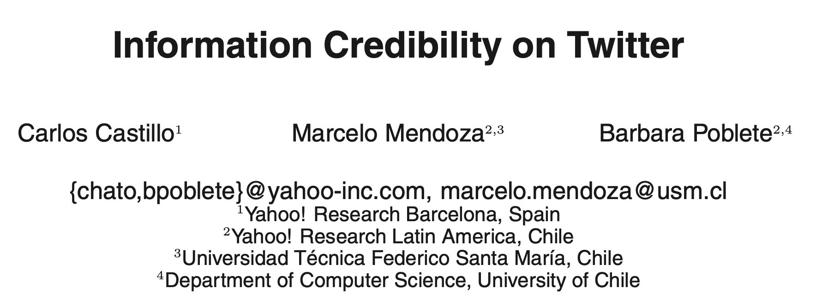
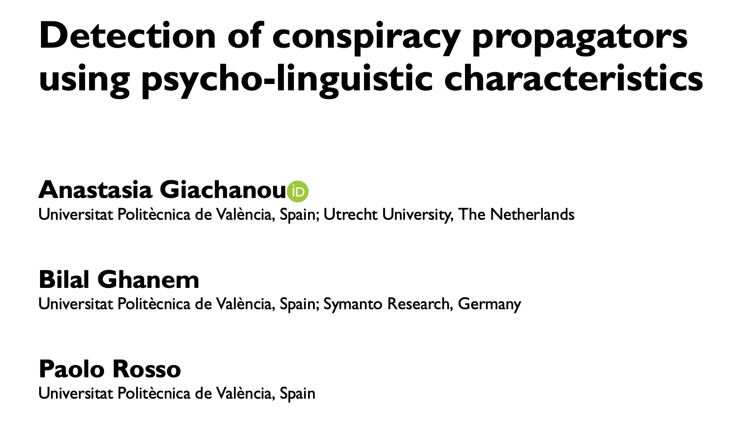
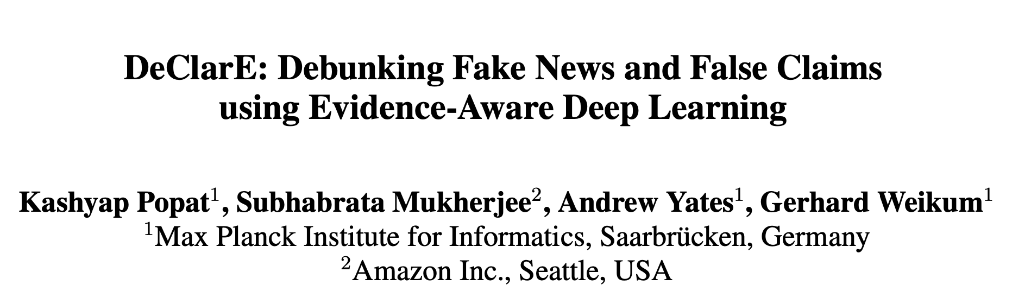
Fake news detection

Slide 14
Information credibility on Twitter
Assessing the credibility of a given set of tweets
Data collection: all tweets matching queries in 2-day window; 2500 topics
Features:
Message-based: length, presence of special chars, sentiment, etc.
User-based: age, number of followers, number followed, etc.
Topic-based: fraction of tweets with URL, fraction of positive, etc.
Propagation-based: depth of re-tweet, number of initial tweets of a topic
Decision Tree classifier
C. Castillo, M. Mendoza, and B. Poblete. (2011). Information credibility on Twitter. In Proceedings of the 20th international conference on World wide web, pp. 675-684

Slide 15
Information credibility on Twitter
Assessing the credibility of a given set of tweets
Data collection: all tweets matching queries in 2-day window; 2500 topics
Features:
Message-based: length, presence of special chars, sentiment, etc.
User-based: age, number of followers, number followed, etc.
Topic-based: fraction of tweets with URL, fraction of positive, etc.
Propagation-based: depth of re-tweet, number of initial tweets of a topic
Decision Tree classifier
Evaluation?
C. Castillo, M. Mendoza, and B. Poblete. (2011). Information credibility on Twitter. In Proceedings of the 20th international conference on World wide web, pp. 675-684

Slide 16
Information credibility on Twitter: Results
F1 = 0.7-0.8
C. Castillo, M. Mendoza, and B. Poblete. (2011). Information credibility on Twitter. In Proceedings of the 20th international conference on World wide web, pp. 675-684

Slide 17
Fake news detection

Slide 18
Today
Applications of text mining
Fake news detection
Hate speech detection
Text clustering in media
Healthcare applications
Interpretability

Slide 19
Hate Speech
Social media enable its propagation
Hate speech detection crucial to reducing crime, protecting people
2023: D66 leader Sigrid Kaag stopped with politics. She mentions "hate, intimidation and threats" and the effect on her family as the reason to stop [0]
[0] https://nos.nl/nieuwsuur/artikel/2482833-toelichting-twitter-reacties-op-vertrek-sigrid-kaag
Notes:
When would you remove ”not” as a stop word?
We provide a data set of 16k tweets annotated for hate speech. We also inves- tigate which of the features we use provide the best identification performance. We analyze the features that improve detection of hate speech in our corpus, and find that despite presumed differ- ences in the geographic and word-length distribu- tion, they have little to no positive effect on per- formance, and rarely improve over character-level features. The exception to this rule is gender.
manually annotated our data set
We find that the most influential features for the logistic regression (see Table 5) largely correspond with the most frequent terms in Table 2. We see, for instance different n-gram lengths of the word “Islam” and “sexist”.
Intuitively, it makes sense that not only will the most frequent terms be indicative, but also that character n-grams would outperform word n- grams, due to character n-gram matrices being far less sparse than the word n-gram matrices.

Slide 20
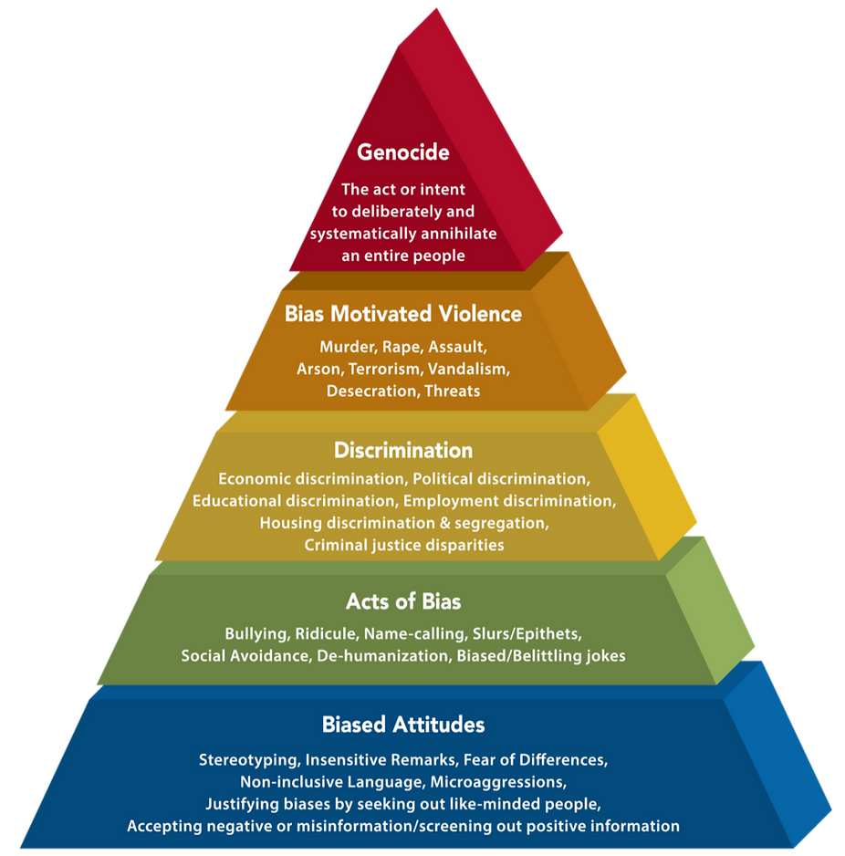
Hate Speech Definition
The 2019 UN Strategy and Plan of Action on Hate Speech
‘Attacks or uses pejorative or discriminatory language with reference to a person or a group on the basis of who they are, in other words, based on their religion, ethnicity, nationality, race, colour, descent, gender, or other identity factor’.

Slide 21
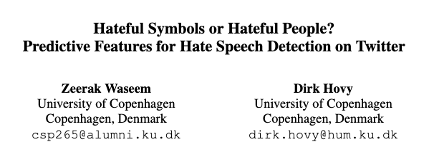
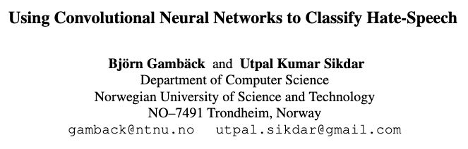
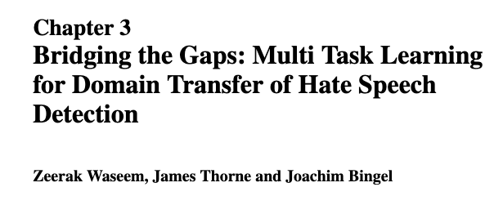
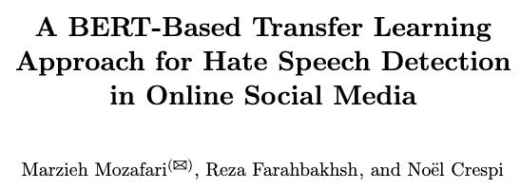
Hate Speech in Twitter

Slide 22
Hateful Symbols
Data: Annotation of 16k tweets based on Gender studies and Critical Race Theory (CRT)
Method: TD-IDF using character {uni, bi, tri}-grams.
Why did they use characters instead of words?
Z. Waseem and D. Hovy. 2016. Hateful Symbols or Hateful People? Predictive Features for Hate Speech Detection on Twitter. In Proceedings of the NAACL Student Research Workshop, pages 88–93,. ACL.

Slide 23
Hateful Symbols
Data: Annotation of 16k tweets based on Gender studies and Critical Race Theory (CRT)
Method: TD-IDF using character {uni, bi, tri}-grams.
Why did they use characters instead of words?
Preprocessing: Removing stop words (except “not”), usernames and punctuation
Z. Waseem and D. Hovy. 2016. Hateful Symbols or Hateful People? Predictive Features for Hate Speech Detection on Twitter. In Proceedings of the NAACL Student Research Workshop, pages 88–93,. ACL.
Notes:
When would you remove ”not” as a stop word?

Slide 24
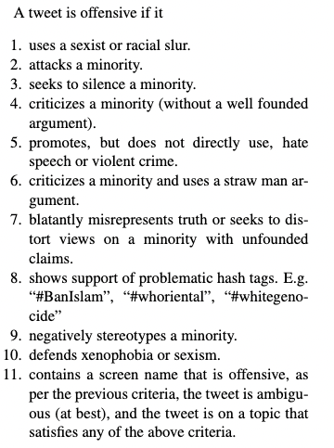
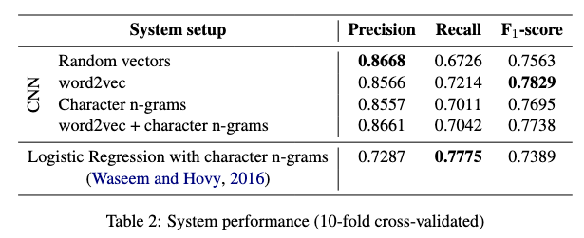
Hateful Symbols
Data: Annotation of 16k tweets based on Gender studies and Critical Race Theory (CRT)
Method: TD-IDF using character {uni, bi, tri}-grams.
Why did they use characters instead of words?
Preprocessing: Removing stop words (except “not”), usernames and punctuation
Classifier: Logistic Regression
Results:
Z. Waseem and D. Hovy. 2016. Hateful Symbols or Hateful People? Predictive Features for Hate Speech Detection on Twitter. In Proceedings of the NAACL Student Research Workshop, pages 88–93,. ACL.

Slide 25
Hate Speech in Twitter
Notes:
What do the others add?

Slide 26
Today
Applications of text mining
Fake news detection
Hate speech detection
Text clustering in media
Healthcare applications
Interpretability

Slide 27
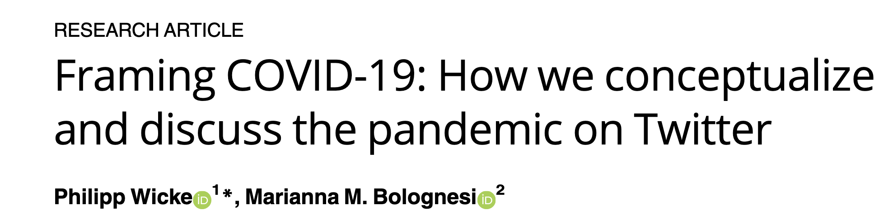

Application of Text Clustering in Media

Slide 28
COVID pandemic (Wicke & Bolognesi 2020)
Question:
- To what extent is the WAR figurative frame and the conventional metaphor DISEASE TREATMENT IS WAR used to talk about Covid-19 on Twitter?
- Which lexical units are used within this metaphorical frame and which lexical units are not?
- Framing of WAR (fight, combat, battle), STORM (wave, storm, cloud), MONSTER (evil, horror, killer) or TSUNAMI (wave, tragedy, catastrophe).
Data: Twitter around #Covid-19 (80 hashtags) - 25.000 tweets per day
Method: LDA (4 and 16 topics) + correlation of topics with frames
Preprocessing: Remove stop words, remove covid, remove tokes with less than 3 characters
Notes:
Consequently, we explored the actual usage of the WAR frame, and explored which topics (among the topics identified in the first part of the study) are more frequently framed within the metaphor of WAR.
To do so, we compiled a list of war-related lexical units and ran it against our corpus of Covid-19 tweets, observing and discussing which lexical units of each frame were used in the tweets, and within which topics.
The results show that 5.32% of all tweets contain war-related terms and are therefore likely to frame the discourse around Covid-19 metaphorically, in terms of a literal war.

Slide 29
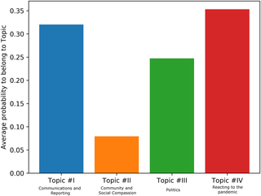
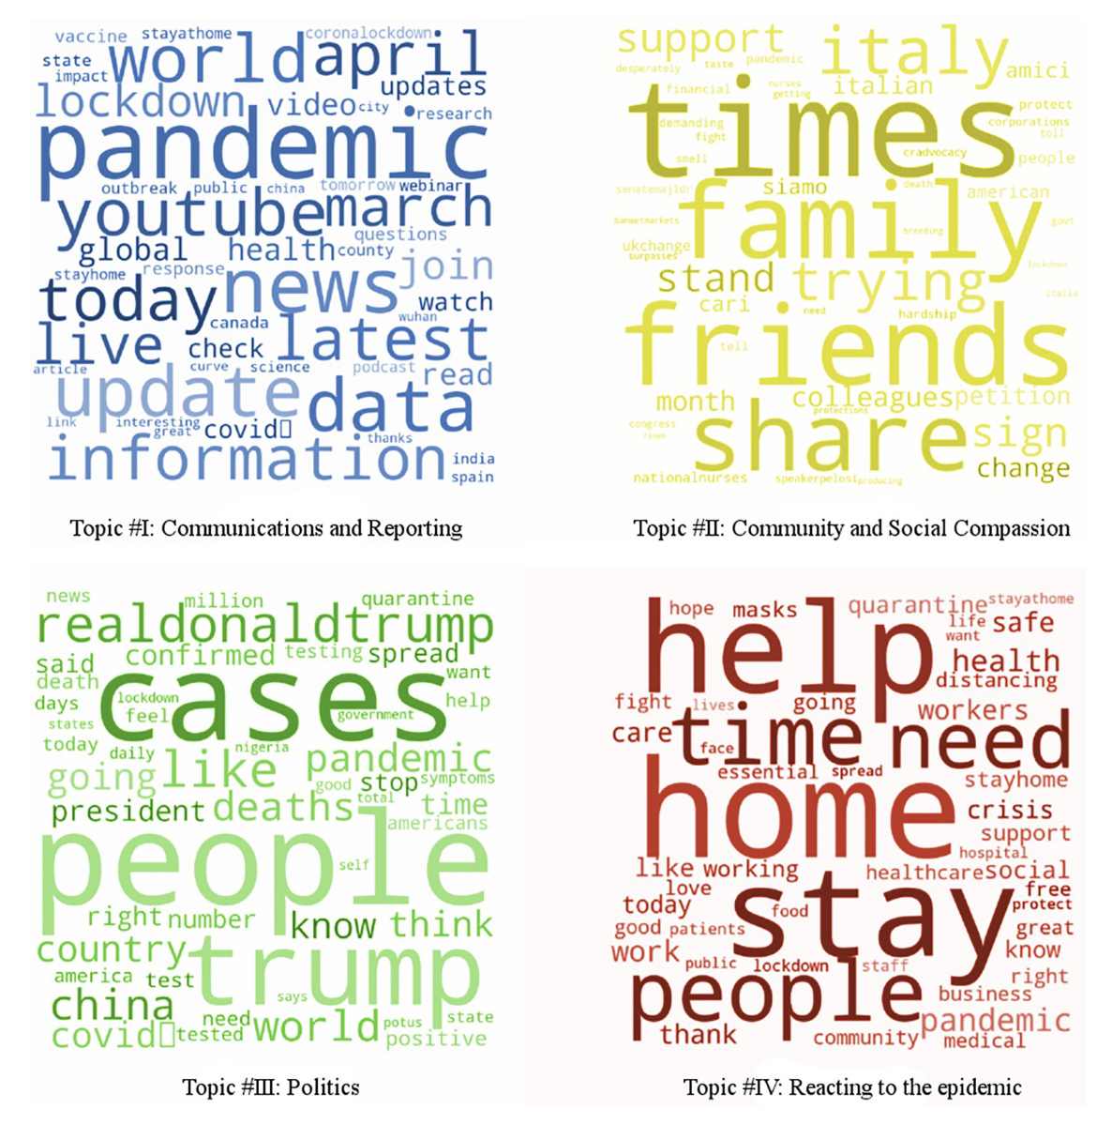
COVID pandemic (Wicke & Bolognesi 2020)
LDA-predicted average probability of WAR term contributing to one of 4 topics.
The results show that 5.32% of all tweets contain war-related terms

Slide 30
Application of Text Clustering in Media

Slide 31
Today
Applications of text mining
Fake news detection
Hate speech detection
Text clustering in media
Healthcare applications
Interpretability

Slide 32
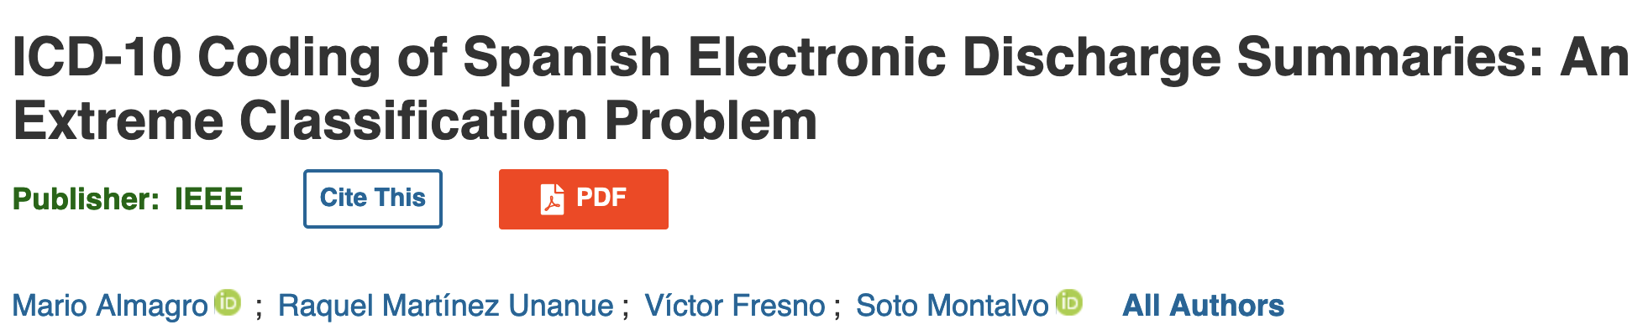

Applications in Health: Automating coding

Slide 33
ICD-10 coding
Medical coding is used to identify and standardize clinical concepts in the records collected from healthcare services
The ICD- 10 is the most widely-used coding with more than 11,000 different diagnoses, affecting research, reporting, and funding

Slide 34
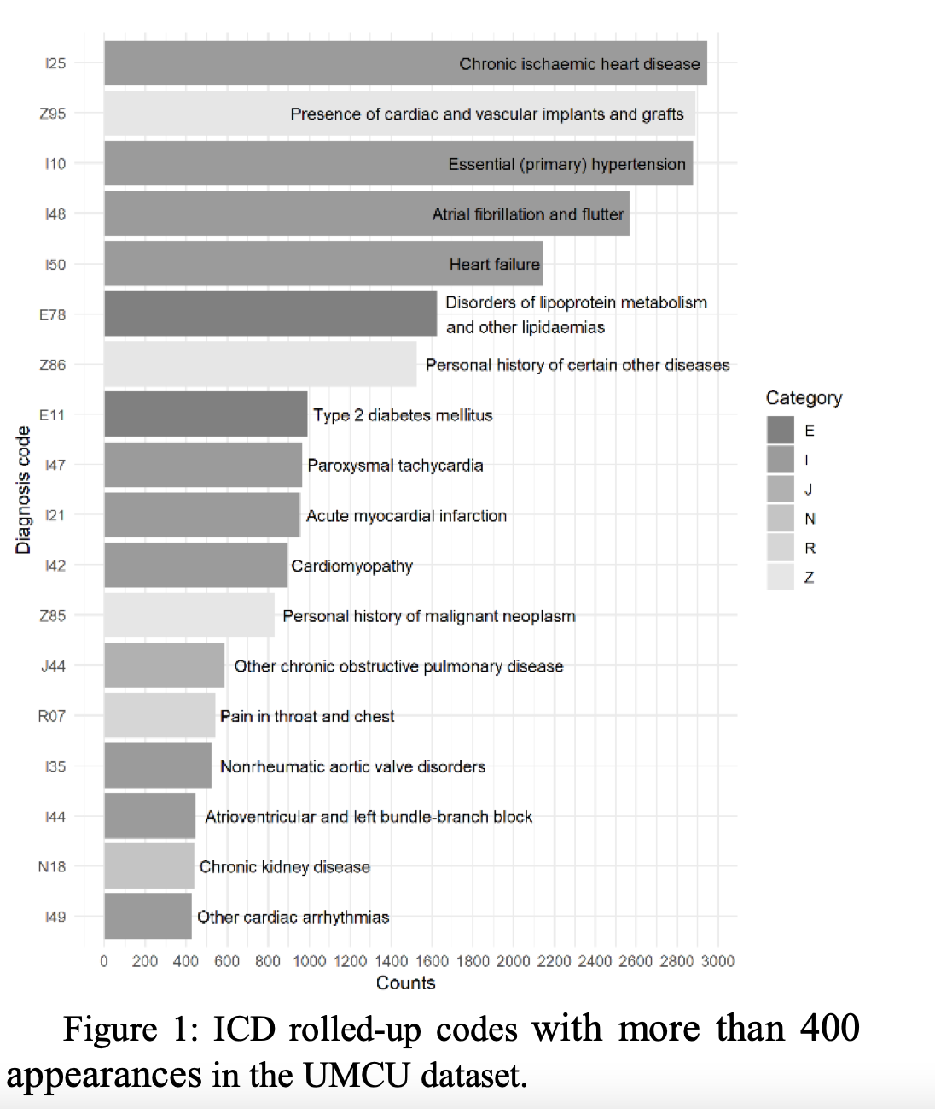
Bagheri, Sammani, van der Heijden, Asselbergs, Oberski, 2020
Question: The proposal is conceived to be applied in a real system, suggesting a list of the 10 most probable codes to experts
Data: 6k discharge reports, with 1k ICD-10 (diseases, abnormal findings, causes of injury…). Cardinality=5
Method: Different methods
Preprocessing: removed small labels, trimmed whitespaces, numbers and converted all characters to lowercase
Results:

Slide 35
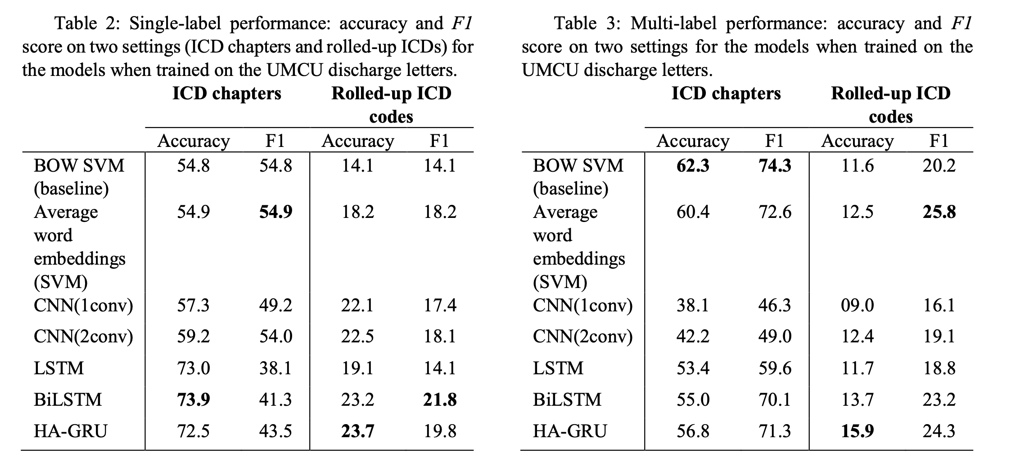
Bagheri, Sammani, van der Heijden, Asselbergs, Oberski, 2020

Slide 36
Applications in Health: Automating coding

Slide 37
How to know if your results make sense?

Slide 38
Interpretability Being right for the right reasons
Model-dependent
Designed for a particular type of model.
They leverage the inner workings and characteristics of the model to explain its behavior
Model-agnostic
?

Slide 39
Interpretability Being right for the right reasons
Model-dependent
Designed for a particular type of model.
They leverage the inner workings and characteristics of the model to explain its behavior
Model-agnostic
Not tied to a specific model type and can be applied to any machine learning model

Slide 40
Interpretability Being right for the right reasons
Model-dependent
Designed for a particular type of model.
They leverage the inner workings and characteristics of the model to explain its behavior
Model-agnostic
Not tied to a specific model type and can be applied to any machine learning model
Global interpretability
Understanding the overall behavior of a model across its entire input space. Holistic view of the model's decision-making process and its underlying logic
Local interpretability
?

Slide 41
Interpretability Being right for the right reasons
Model-dependent
Designed for a particular type of model.
They leverage the inner workings and characteristics of the model to explain its behavior
Model-agnostic
Not tied to a specific model type and can be applied to any machine learning model
Global interpretability
Understanding the overall behavior of a model across its entire input space. Holistic view of the model's decision-making process and its underlying logic
Local interpretability
Explaining individual predictions.
Why a particular prediction was made by analyzing the specific input features that influenced the decision

Slide 42
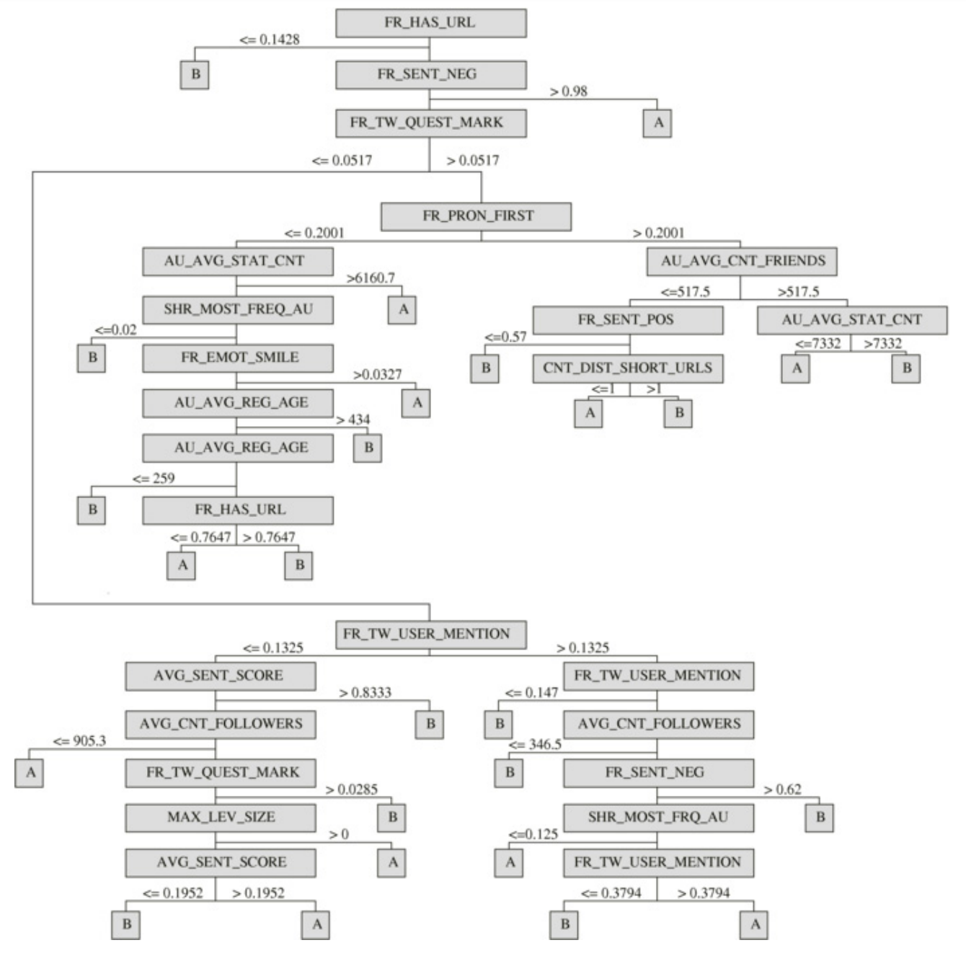
Interpretability: Model-dependent
Notes:
Model-dependent interpretability techniques are designed specifically for a particular type of machine learning model. They leverage the inner workings and characteristics of the model to explain its behavior. These techniques often rely on model-specific properties, such as feature importance scores from decision trees or gradients in deep neural networks, to provide interpretability.
In contrast, model-agnostic interpretability techniques are not tied to a specific model type and can be applied to any machine learning model. These techniques focus on understanding the model's behavior without relying on its internal structure or properties. Model-agnostic interpretability methods often involve creating surrogate models or using post-hoc explanation techniques, such as feature importance scores or local perturbations, to gain insights into a model's predictions.

Slide 43
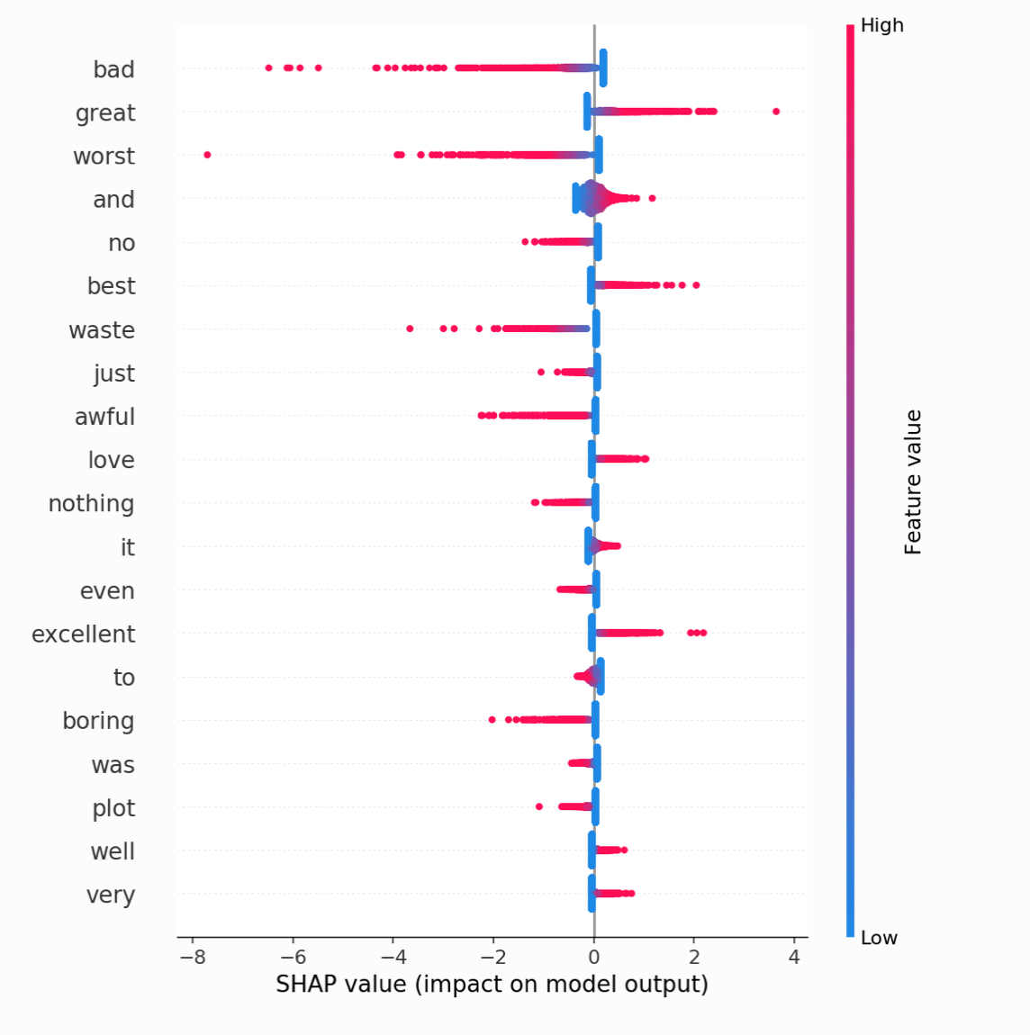
Global Interpretability
You train a sentiment analysis model
Analyze the feature importance scores or coefficients of the model
You find that features related to emotional words have higher importance scores
This global interpretability analysis reveals the common patterns and factors that contribute to the classification of document as positive or negative
Notes:
effect of all the features

Slide 44
Local Interpretability
You have a trained sentiment analysis model that classifies a document as positive or negative
You select a specific review classified as positive
Why the model made that prediction?
Analyze the most influential features or words in the article that contributed to the positive classification
Presence of words like ”good," ”amazing," had a strong positive influence on the model's decision
Notes:
In contrast, model-agnostic interpretability techniques are not tied to a specific model type and can be applied to any machine learning model. These techniques focus on understanding the model's behavior without relying on its internal structure or properties. Model-agnostic interpretability methods often involve creating surrogate models or using post-hoc explanation techniques, such as feature importance scores or local perturbations, to gain insights into a model's predictions.

Slide 45
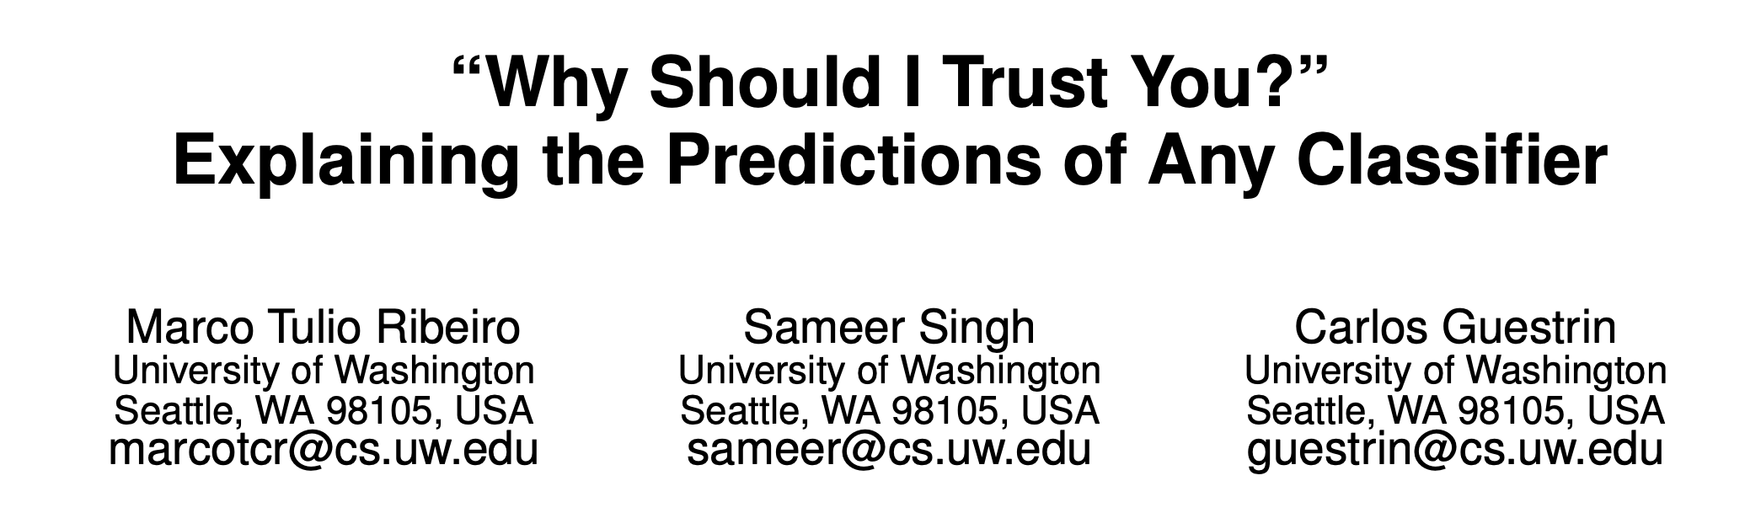
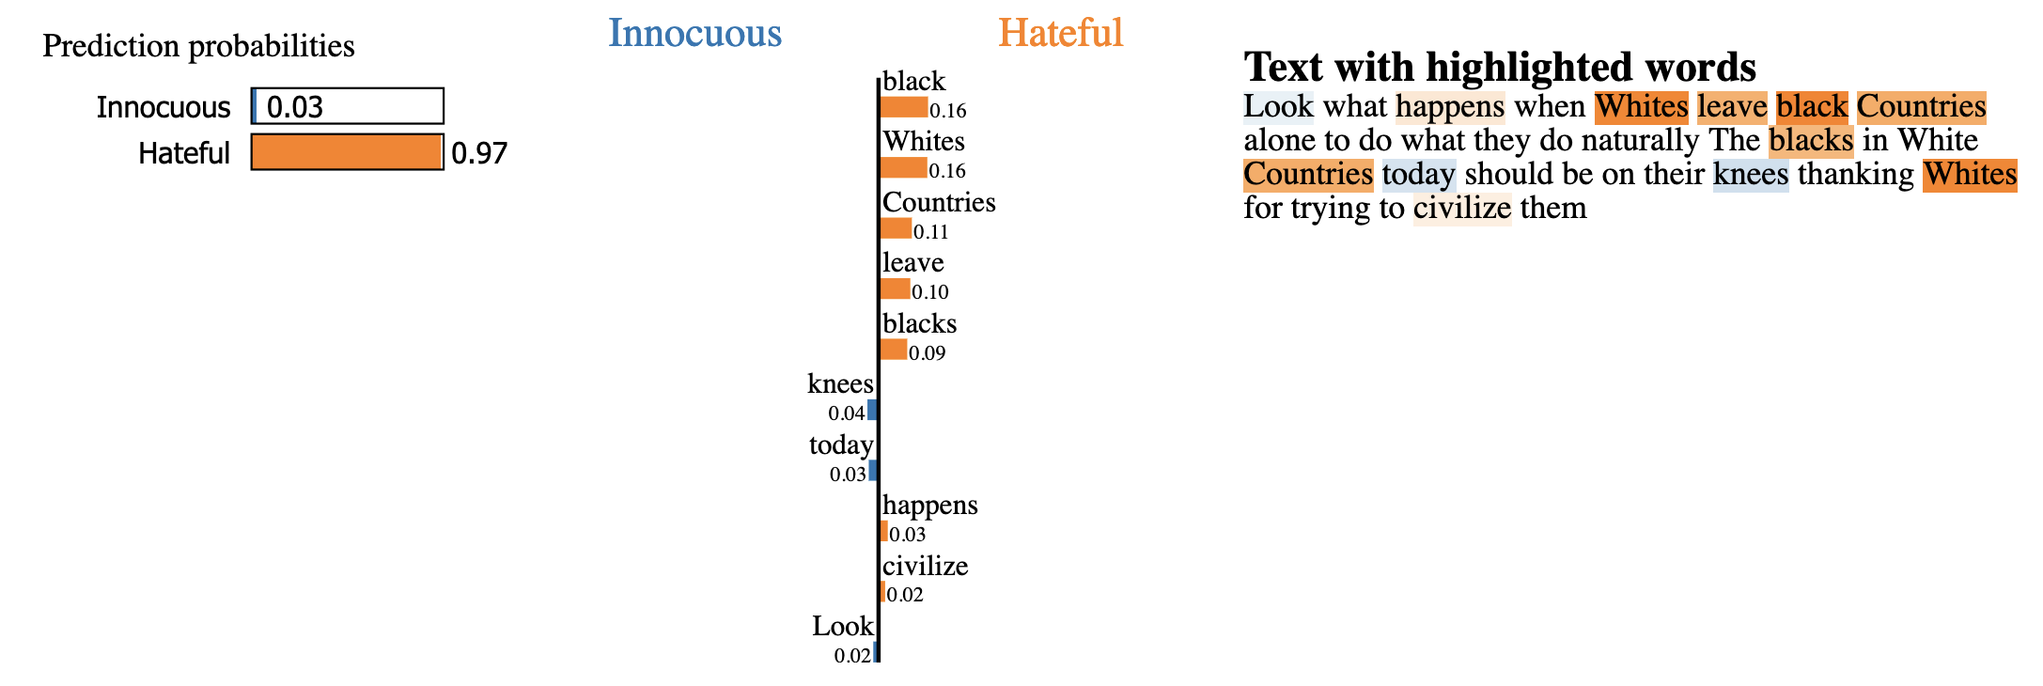
Local interpretability - LIME
LIME (Local Interpretable Model-Agnostic Explanations) creates simple and interpretable surrogate models for a prediction
It perturbs the input features of an instance and observes how the model's predictions change, allowing to identify the most important features influencing the outcome in a local and understandable way.
Notes:
LIME takes the instance we want to explain and creates slightly modified versions of it by making small changes to its features. These modifications aim to capture the important aspects that influenced the model's prediction.
The perturbation-based approach helps in generating modified instances that capture the important features, while surrogate models aid in approximating the behavior of the black-box model locally.
Surrogate Model: LIME creates a simpler and interpretable model called a surrogate model. It is trained on the modified instances and their corresponding predictions from the original black-box model.
Perturbation-Based Approach: LIME employs a perturbation-based approach to explain individual predictions. It involves creating modified versions of the input instance by making small changes to its features. These modifications aim to highlight the important aspects of the instance that influenced the model's prediction. The modified instances are then used to understand the behavior of the model locally.
Surrogate Models: Surrogate models, on the other hand, are simpler and interpretable models that approximate the behavior of the black-box model locally. In LIME, a surrogate model is trained on the modified instances and their corresponding predictions from the original black-box model. The surrogate model acts as a local approximation of the black-box model for the specific instance being explained.

Slide 46
Practical 9

